Slide 1


L4:
Deep Learning &
Artificial Intelligence
Digital Health
UCSD Extension – Specialization Certificate
Data Science for Healthcare
Hobson Lane, UC San Diego
Instructor

Slide 2
Syllabus
Wk. | Title | Topics | Exercise
0 | Data Science in Healthcare | applications, terminology, HIPPA | anonymize dataset PII
1 | Spreadsheet Data Science | ETL, exploration & visualization | height, weight, BMI, gender
2 | Statistics | causality, correlation, MLE | causal diagram “games”
3 | Clinical Data Science & Machine Learning | PII, prescriptive vs descriptive | predict diabetes risk
4 | Deep Learning & AI | neural nets, radiology, CV | train diagnostic neural net
4 | Hospital Performance Modeling | time series, unintended conseq. | Mid-term Quiz!
5 | Population Health (Epidemiology) | GIS, spatio-temporal modeling | visualize/analyze Ebola
6 | Scoping Review & Gap Analyses | diabetes, military women | review smoking research
8 | Natural Language Processing | IA, summarization, text mining | find summary with spaCy
9 | Occ. Health & Assistive Tech. | Tesla & Aira case studies, OSHA | analyze medicine OCR app.
10 | Policy, Privacy and Ethics | bias, fairness, anonymization | Final Exam!
Proj | Train your own healthcare model | find/download data, ETL, | fit/train a DS model

Slide 3
What is Deep Learning?
What is AI?
How do they apply to healthcare?

Slide 4
Assignments

Slide 5
Quiz
Why is understanding Baye’s Rule so important?

Slide 6
Homework:
Start your Hyperparameter Log
Create an empty spreadsheet, python list, or paper table with headings: num input dimensions, layer 1 neurons, layer 2 neurons, layer 3 neurons, training set accuracy, test set accuracy (see next slide)
Train two neural networks to predict MNIST hand-written digits and record your hyperparameters (numbers of neurons) and performance (accuracies)
TIP: Start with 0 neurons for layer 2 and layer 3

Slide 7
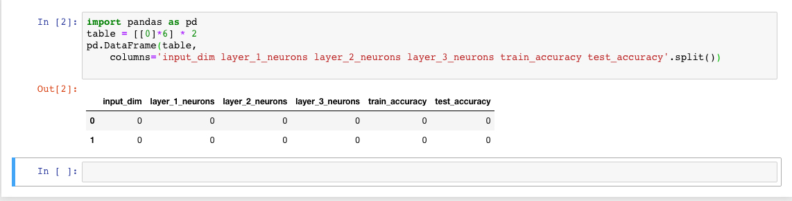
Example Python

